Slide 1

Duplicate Record
Clustering Algorithms
Efficiently detect potential duplicates for user resolution. The cosine similarity algorithm is effective for determining text similarity.
Cody Clair | Israel Fuller | Benjamin Small | Timothy Laryea

Slide 2
Naive vs. Current Solution
Naive Solution
Current Solution
Compares every record to every other record.
Sorts attributes and compares to the next few entries.
O(n^2) complexity makes it slow for large datasets.
Faster but misses duplicates like "John" and "JJohn".

Slide 3

Failed Approaches
1
MinHash- Cedarville solution
Previous team's solution had limitations, and we felt like we
could improve on it with the allotted time.
2
Simple Vector Sorting
IWe

Slide 4

Sliding Window
The sliding window is used by the cosine algorithm to check for duplicates.
It checks a number of sorted records below it for each record.

Slide 5

Proposed Solution: K-means Clustering
Uses K-means clustering to create centroids and vector points.
Clusters based on the smallest distance from the centroid point.

Slide 6

Proposed Solution: Indexing
Creates a test table with an index and metaphone values.
Clusters data based on substrings of metaphone values.

Slide 7





Indexing Steps
Create Table
Create table with index and metaphone.
Insert Data
Insert key, field value, and metaphone.
Select Index
Select index field between substrings.
Check Distance
Check full name with Levenshtein distance.

Slide 8
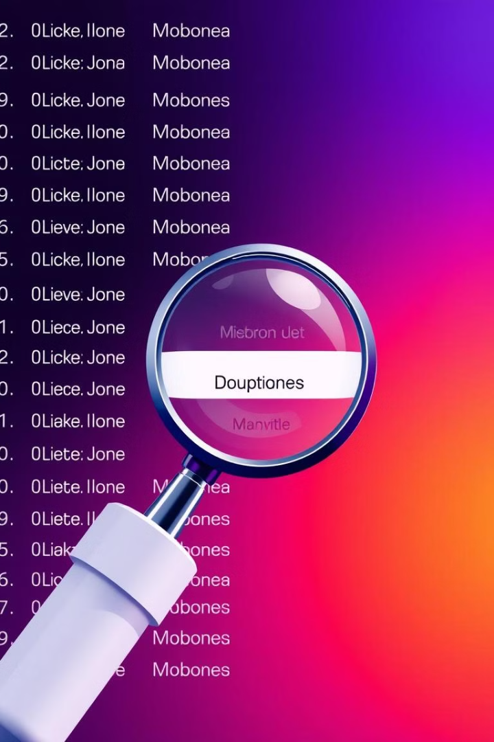
Indexing Benefits
Misspelled Names
Minor Differences
Finds misspelled name errors.
Detects minor character differences.
Pronunciation
Handles differences in pronunciation.

Slide 9





Relevant Attributes
First Name
Surname
Address
p_preferred_name or given_name.
p_surname.
p_address_1, p_address_2, etc.
Email
p_contact_info (p_contact_type = "E").

Slide 10


Relevant Attributes (cont.)
Phone Number
p_phone_area_city, p_contact_info.

